Slide 1

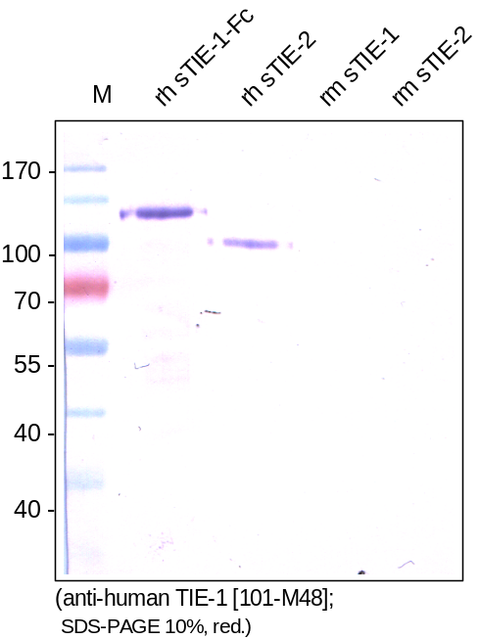
ReliaTech GmbH
Mouse anti-human TIE-1 #6F12
(Cat #101-M48)
Figure 1. Western analysis with different recombinant soluble human and mouse TIE-1 and TIE-2 proteins using a mouse monoclonal anti-human TIE-1 #6F12 antibody [Cat# 101-M48]. There is a cross reactivity with human sTIE-2 [Cat# S01-044] visible.
http://www.reliatech.de / orders@reliatech.de

